Slide 1
Fasal.ai Team id - 102

Slide 2
Problem Statement
Farmers face multiple crop growing challenges, and climate change has only added to these challenges. Using the various datasets provided, efforts have been made to help farmers increase income by suggesting crop choice strategies.

Slide 3
the datasets
AREA,
PRODUCTION
& YIELD
PRICE & ARRIVALS
COST OF CULTIVATION
RAINFALL
TEMPERATURE

Slide 4
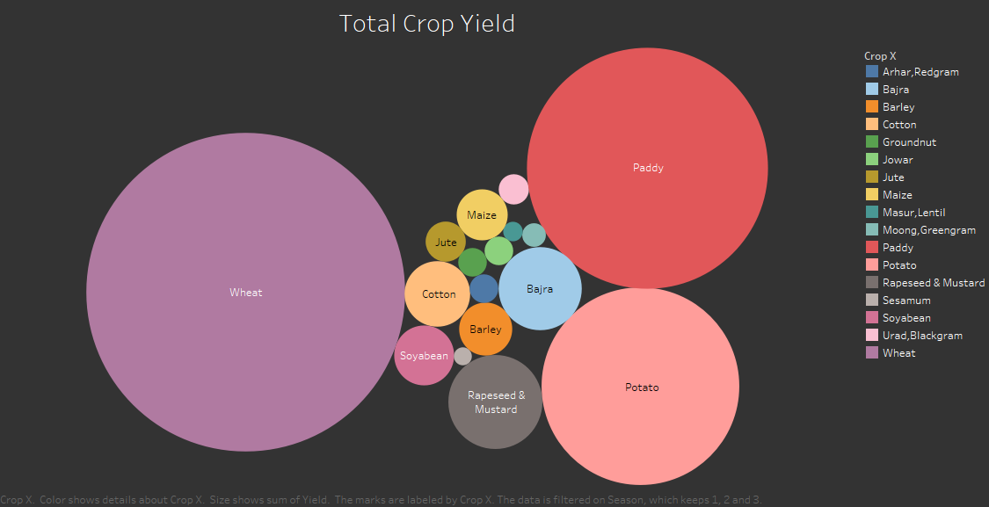
TOTAL CROP YIELD
Wheat, paddy and potato are crops with highest yield. SesaMum (TIL) is the crop with lowest yield.

Slide 5
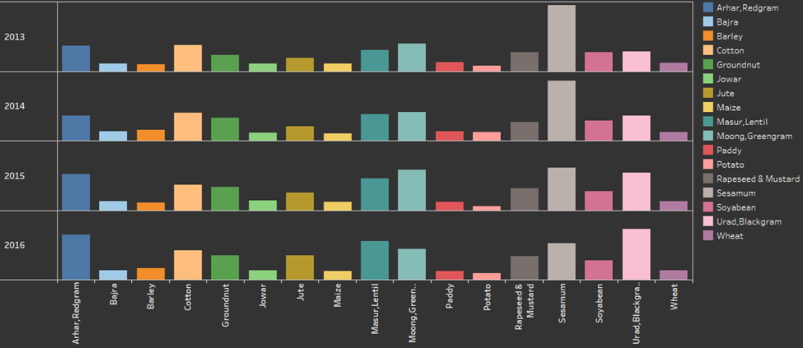
DISTRIBUTION OF MODAL PRICES
Due To government subsidies, the prices of commodities are not affected by the arrivals (Supply)

Slide 6
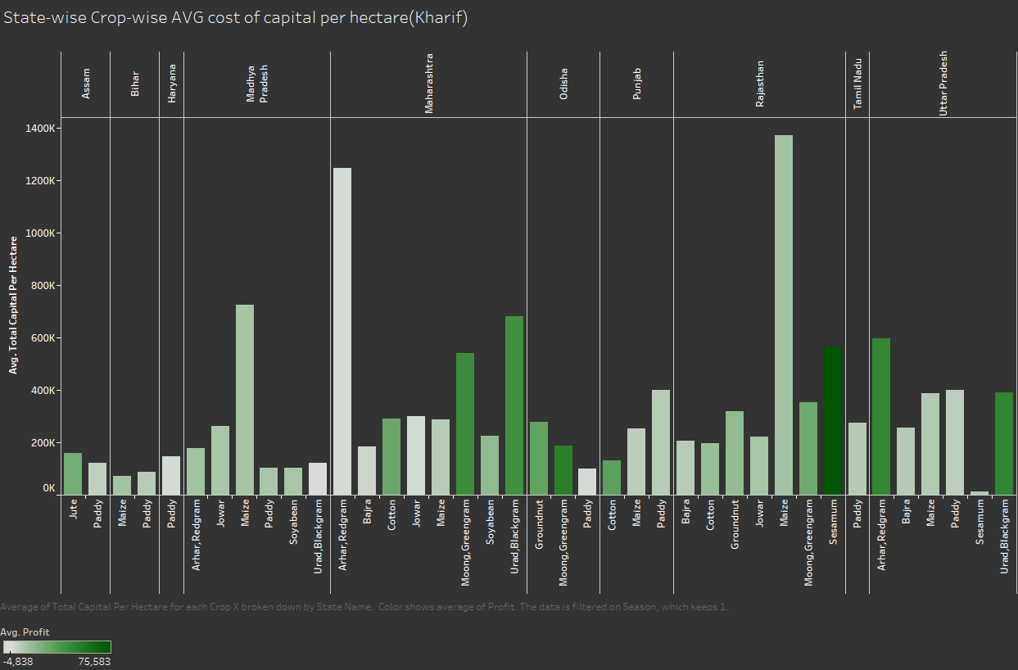
Avg. Total capital per hectare (Kharif)
Maize in Rajasthan and Arhar in Maharashtra are crops with highest Avg. Total capital per hec.
Moong in ODISHA and Sesamum in Rajasthan are among the crops with low Avg. Total capital per hec . But with high profit margins

Slide 7
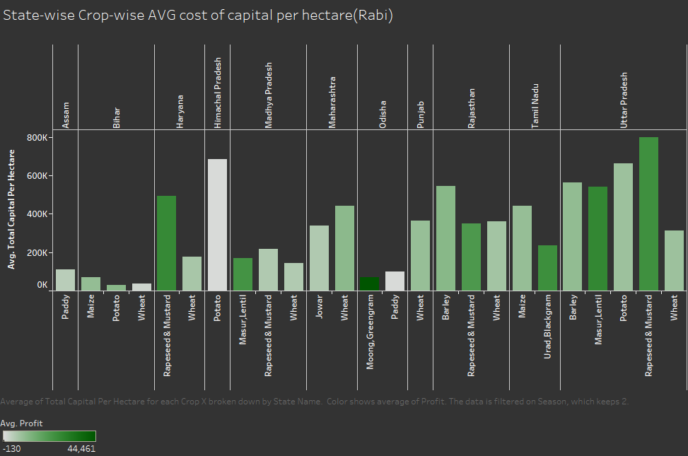
Avg. Total capital per hectare (Rabi)
Potato in himachal Pradesh has high avg. total capital per hectare but incurs losses.
Moong in Odisha has low avg. total capital per hectare and very high profits.

Slide 8
OPERATIONAL COST
Irrigation Charges
Fertilizer manure
Total Labour
Seed
Insecticides
Human Labour
Animal Labour
Machine Labour
‹#›

Slide 9
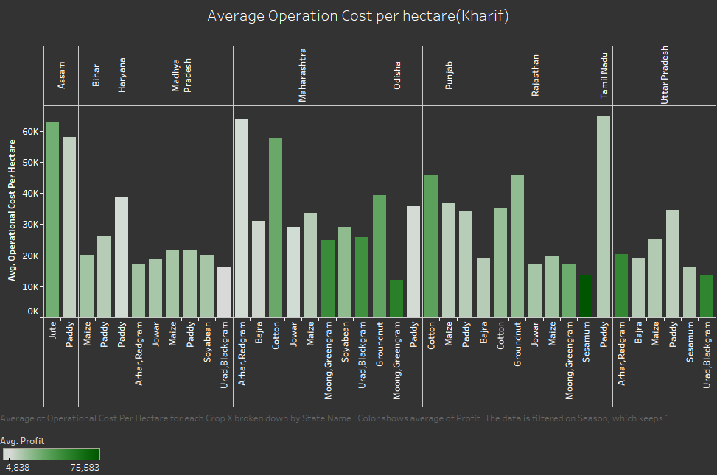
Avg. OPERATIONAL COST per hectare (Kharif)
Jute & PADDY in ASSAM ,Arhar & COTTON in Maharashtra AND PADDY IN TAMIL NADU are crops with highest Avg. OPERATIONAL COST per hec.
Moong in ODISHA and Sesamum in Rajasthan are among the crops with low Avg. OPERATIONAL COST per hec . But with high profit margins

Slide 10
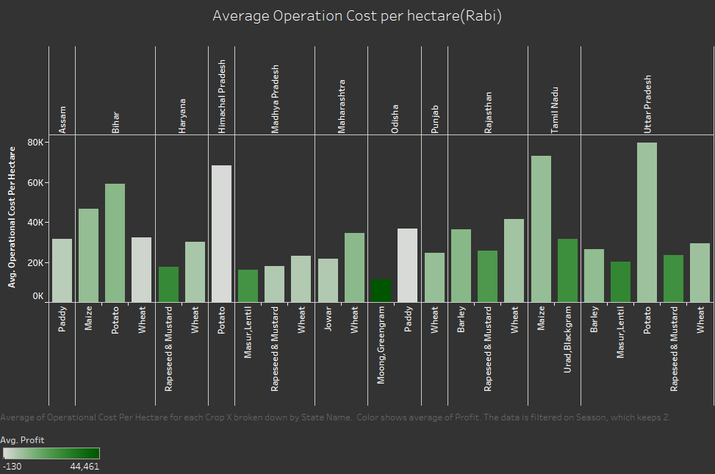
Avg. OPERATIONAL COST per hectare (rabi)
Potato in himachal PradesH & UTTAR PRADESH, MAIZE IN TAMIL NADU has high avg. OPERATIONAL COST per hectare.
Moong in Odisha has low avg. OPERATIONAL COST per hectare and very high profits.

Slide 11
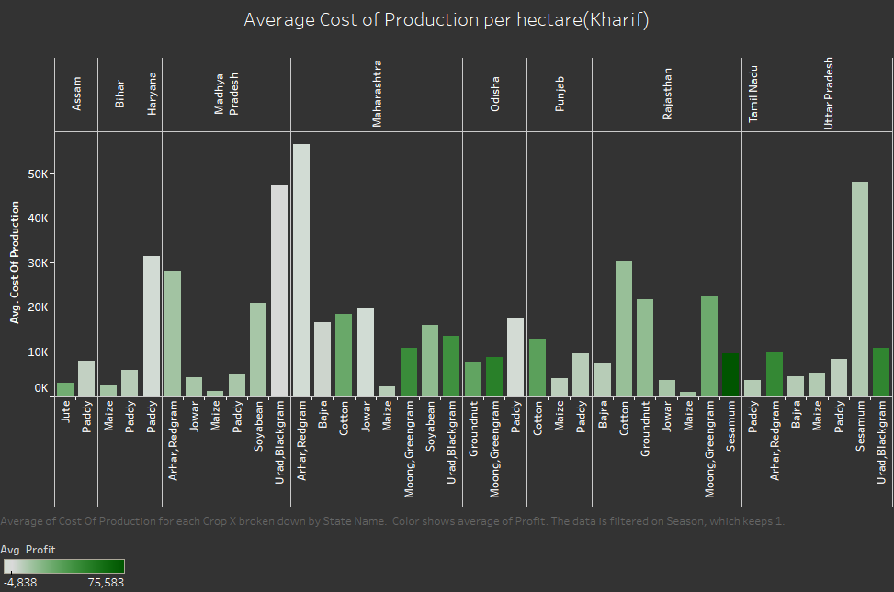
Avg. Cost of PRODUCTION per hectare (Kharif)
URAD MADHYA PRADESH, Arhar in Maharashtra AND SESAMUM IN UTTAR PRADESH are crops with highest Avg. Cost of PRODUCTION per hec.
Maize is the crops with low Avg. Cost of PRODUCTION per hec . In every state with decent profits.
SESAMUM IS THE CROP WITH HIGH EST PROFITS AND LOW Avg. Cost of PRODUCTION per hectare

Slide 12
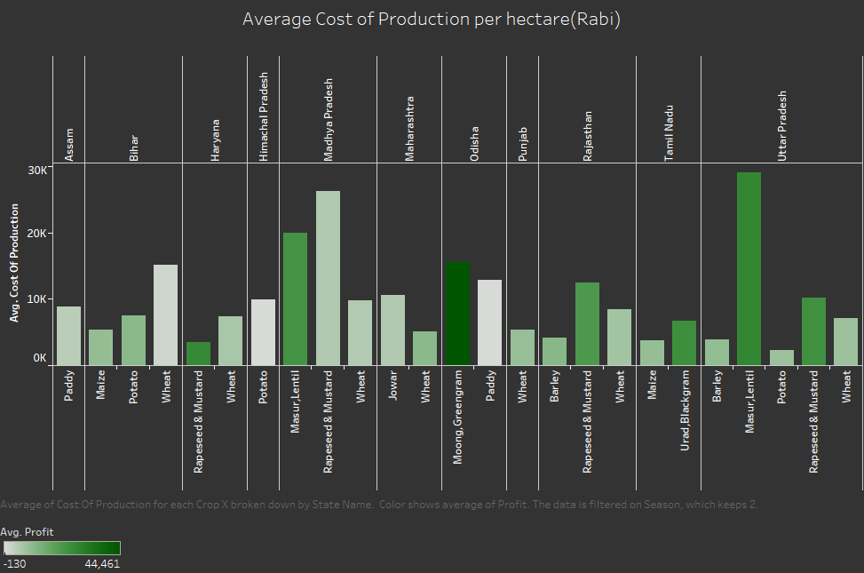
Avg. Cost of PRODUCTION per hectare (RABI)
Masur (Lentil) in UP has high Avg. Cost of PRODUCTION but earns fair profits.
Moong in Odisha has fair Avg. Cost of PRODUCTION but earns the highest profits.

Slide 13
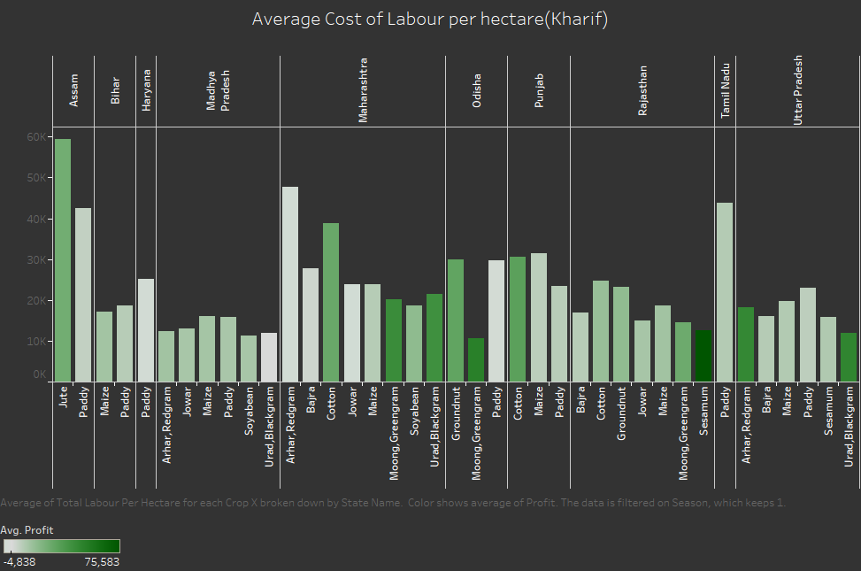
Avg. cost of labour per hectare (Kharif)
Jute in ASSAM ,Arhar in Maharashtra AND PADDY IN TAMIL NADU are crops with highest Avg. cost of labour per hec.
Moong in ODISHA and Sesamum in Rajasthan are among the crops with low Avg. cost of labour per hec . But with high profit margins

Slide 14
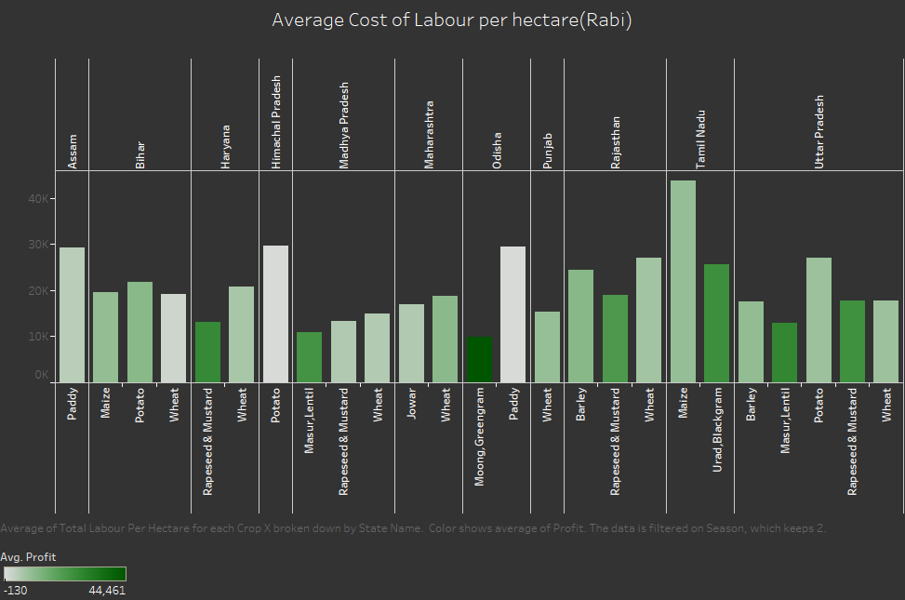
Avg. cost of labour per hectare (rabi)
Potato in himachal PradesH & UTTAR PRADESH, MAIZE IN TAMIL NADU AND PADDY IN ASSAM & ODISHA has high avg. cost of labour per hectare.
Moong in Odisha has low avg cost of labour per hectare and very high profits.

Slide 15
Solution
APPROACH
The generationally gained farming knowledge should be supplemented with the power of data.
INTRODUCING FASAL
Fasal is an analytical tool for farmers and decision makers in government to make data driven decisions.

Slide 16
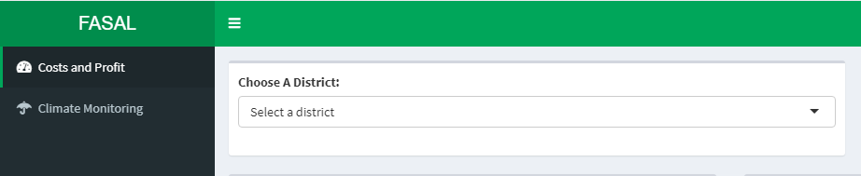
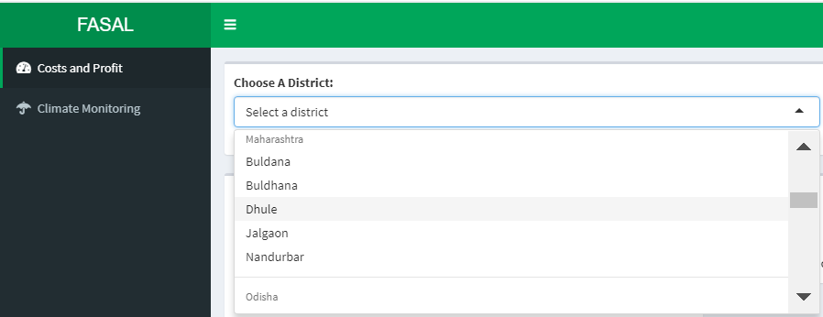
DEMONSTRATING FASAL
CHOOSE THE DISTRICT OF INTEREST
Let’s CHOOSE DHULE DISTRICT FROM MAHARASHTRA STATE HERE

Slide 17
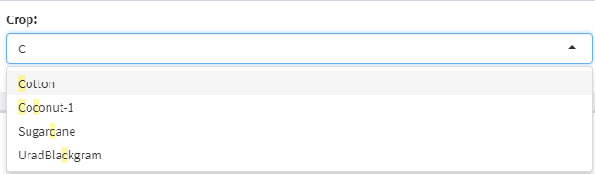
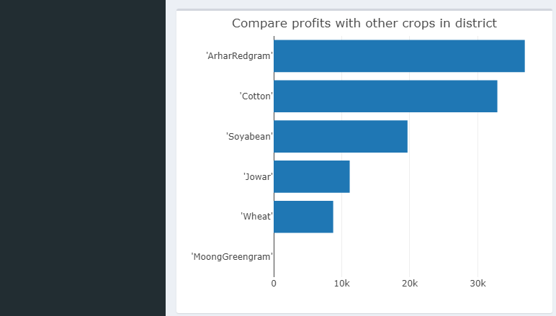
DEMONSTRATING FASAL
CHOOSE THE CROP OF INTEREST
(The most profitable crops can be seen before selecting the crop)
Let’s SELECT COTTON HERE

Slide 18
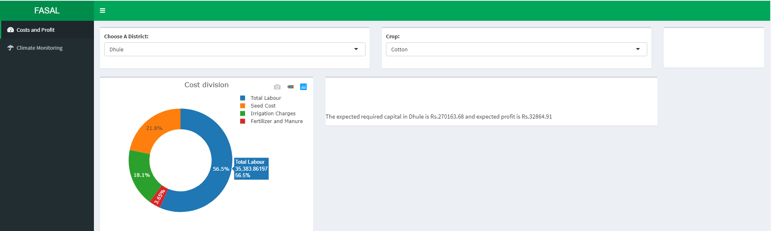
DEMONSTRATING FASAL
THE COST DISTRIBUTION, EXPECTED required Capital
and EXpected profit for the CROP Can be
VIEWED In the costs and profit tab
(Hover over the chart to see actual values)

Slide 19
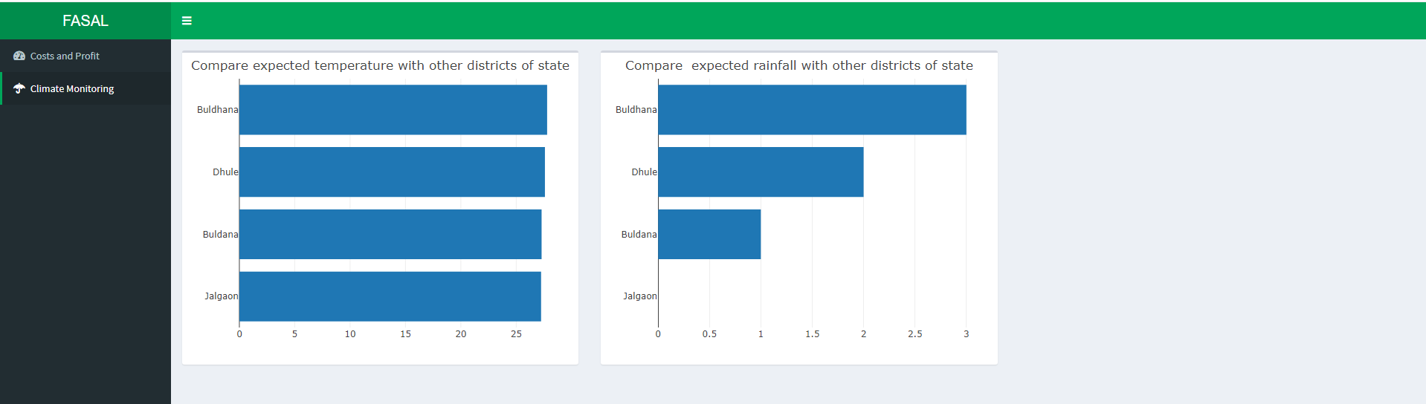
DEMONSTRATING FASAL
The Climate Monitoring TAb can then be used
to analyse the expected rainfall and climate
(We can then identify that the distinguishing factor for production of cotton is rainfall)

Slide 20
HIGHLIGHTS OF USING FASAL
ROBUSTNESS
STATE OF THE art
interactivity
Instead of providing a standard model/approach for each state or district Fasal can be used as per the requirements and judgement of individual farmers
State of the art prediction algorithms are applied which provide robustness and accuracy
The customizable and interactive charts provide more personalised experience

Slide 21




FUTURE SCOPE
TAKE INTO ACCOUNT SOIL FERTILITY IN OUR ANALYSIS
01
EXTEND THE ANALYSIS TO SUB-DISTRICT LEVEL
02
USING LIVE DATA FOR CLIMATE AND CROP CONDITIONS
03
IMPROVE MODEL ACCURACY
04

Slide 22
References
COLAB NOTEBOOK
https://colab.research.google.com/drive/1VAoF3Yf74z1t5NdoCYW1Zpo7-HW5WSyA#scrollTo=wVk8phLxAIx7
COST CALCULATIONS
http://eands.dacnet.nic.in/Cost_Concept/Cost_Con.pdf
FASAL.ai
https://majithiaaarat.shinyapps.io/Fasal102/

Slide 23
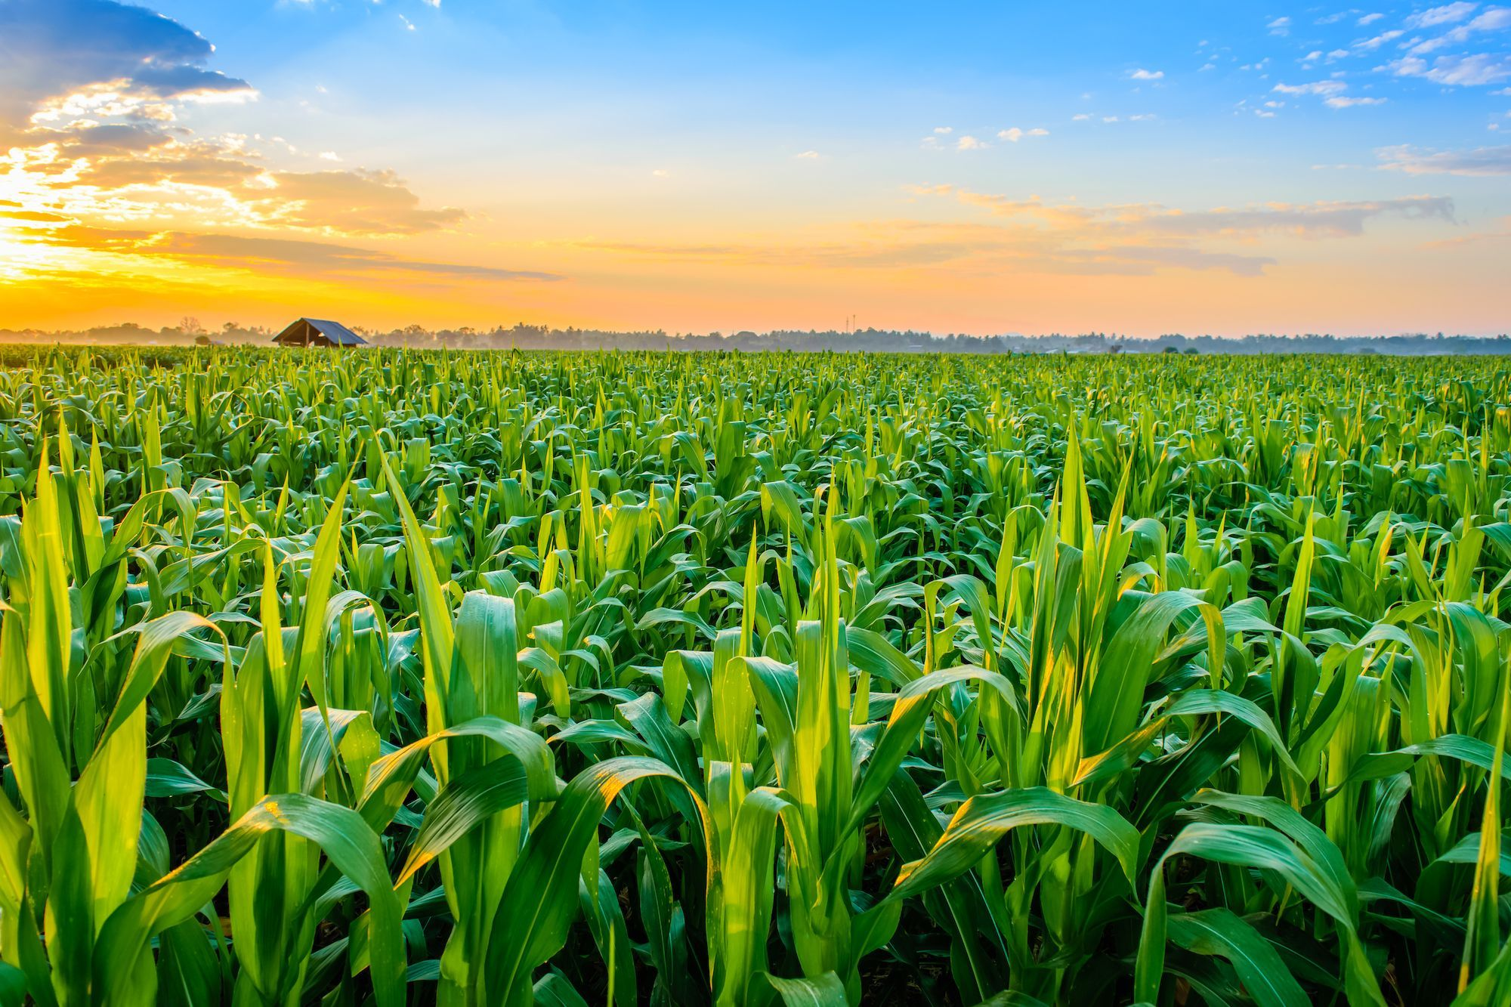
THANK YOU
(FASAL.ai)

